Slide 1
INDUSTRIAL ROBOTICS PROJECT
Ideas and Concepts

Slide 2
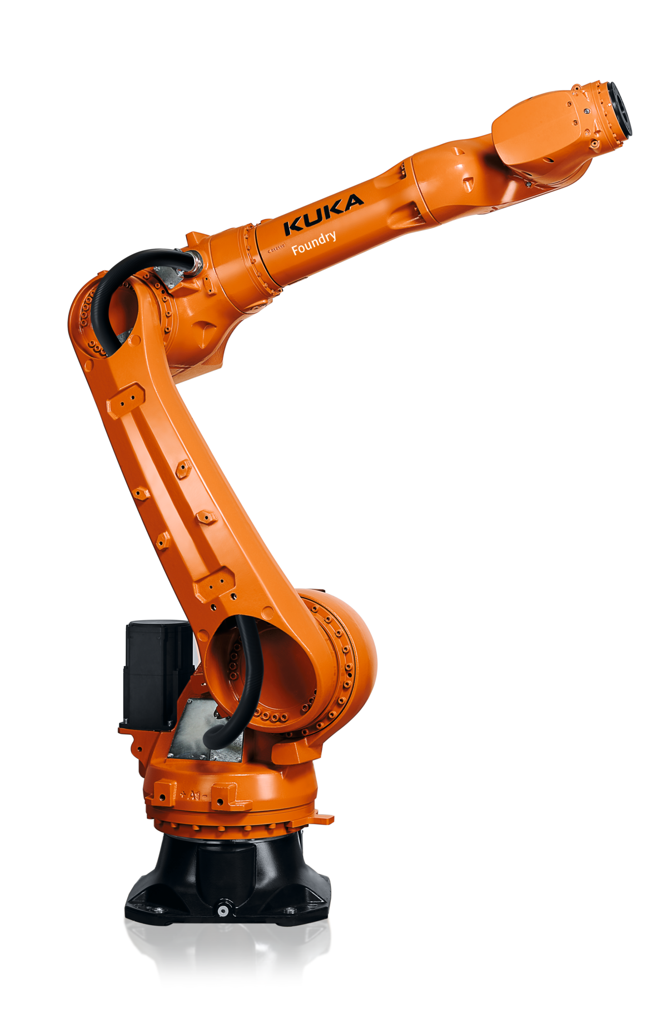
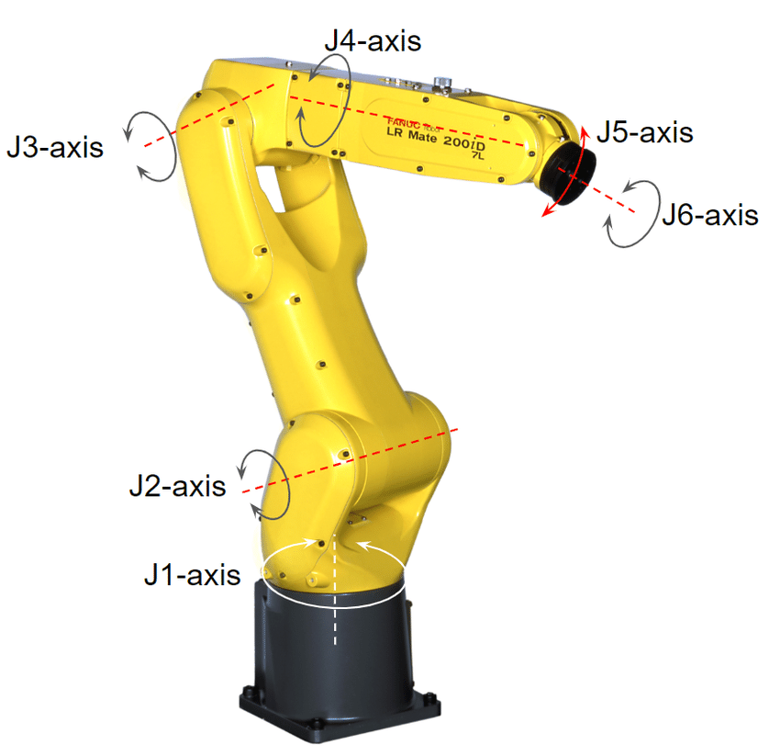
General Idea
Antropomorphic arm with spherical wrist (6 revolute joints)
Orientation on real industrial applications (e.g. KUKA KR 16, Fanuc LR Mate 200iD)

Slide 3
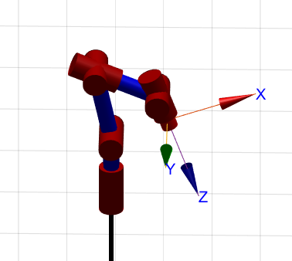
Possible aspects to be included
Basis: Direct Kinematics – DH Parameter
Indirect Kinematics (path planning?)
Singularities or Redundancies
Define min/max joint limits
Evaluate workspace
Manipulability Ellipsoids

Slide 4
Brainstorming
Speed optimzed movement?

